Slide 1
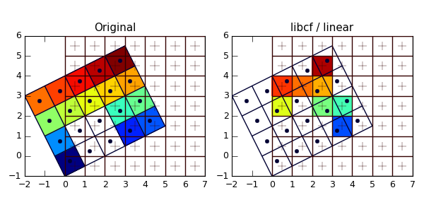
Complex Data Explorer (CODEX) “See What’s In The Data”
Objective:
Develop automated tool using machine learning techniques to quickly scan mission science and engineering data to reveal structures and problems
Can flag anomalies and/or select best subset of data for later, more detailed analysis
Motivation:
Ops, engineering, science datasets are large & complex
Time-critical need to see data contents & quality
Data problems not immediately noticed since buried in data
Custom data monitors limited; much analysis still manual
Major Milestones:
Develop interactive machine learning workflows to support the following areas for exploration:
Clustering (“How many groups?)”
Regression (“Predict this from that”)
Correlation (“What relates to what?”)
Anomaly Detection (“What occurs when?”)
Template Scanning (“Find more like this”)
Data Quality Exploration (“What looks unexpected?”)
Provide a fast and intuitive user interface, which allows the user to rapidly explore their data.
Provide export capabilities for down selected data, plots and code framework to reproduce the exploration outside CODEX.
Anomaly Detection
Population Explanation
Re-grid
Co-locate
Geospatial
Advanced
Correlation
Linked
Selection
Benefits:
Risk Reduction: Rapidly recognize problems in data
Missing values, unexpected correlations
Changes in data relationships, bi-modality
Identify multiple populations: require statistics analysis
Isolate anomalies: for later study or omission
Search by example: “events like this” in entire dataset
Faster Research Results: Weeks of initial survey removed
Rigorous Stats: Understand incoming data distributions
Broad Applicability: All high-dimensional data consumers
Team:
Lukas Mandrake (Concept Formulation & Vision)
Jack Lightholder (Principal Investigator & Server Implementation)
Rob Tapella (User Interface Design & User Experience)
Josh Rodriguez (Front End Development)
Funding Profile: $600K (FY18-20)
Alignment with Strategic Plan:
Reduce mission operations cost and risk
Fast data problem and anomaly identification
Leverage technological advances in computing
Generalizes to Support Future Missions
High performance queries (s/c data) enabling support for faster operational decisions
System applicable to operations, science data analysis, engineering data analysis and multiple mission phases
Mission Relevance:
All planetary/Earth missions with large amounts of data downlink (Europa, M2020, SWOT, OCO3, etc.)
JPL Data Science Pilot Program

